Slide 1
Getting and Cleaning Data
CIHR Course Week 4
Bethany Hedt-Gauthier
Izzie Fulcher

Slide 2
Teaching Objectives
Overview
Outliers
Missing data

Slide 3
Overview

Slide 4
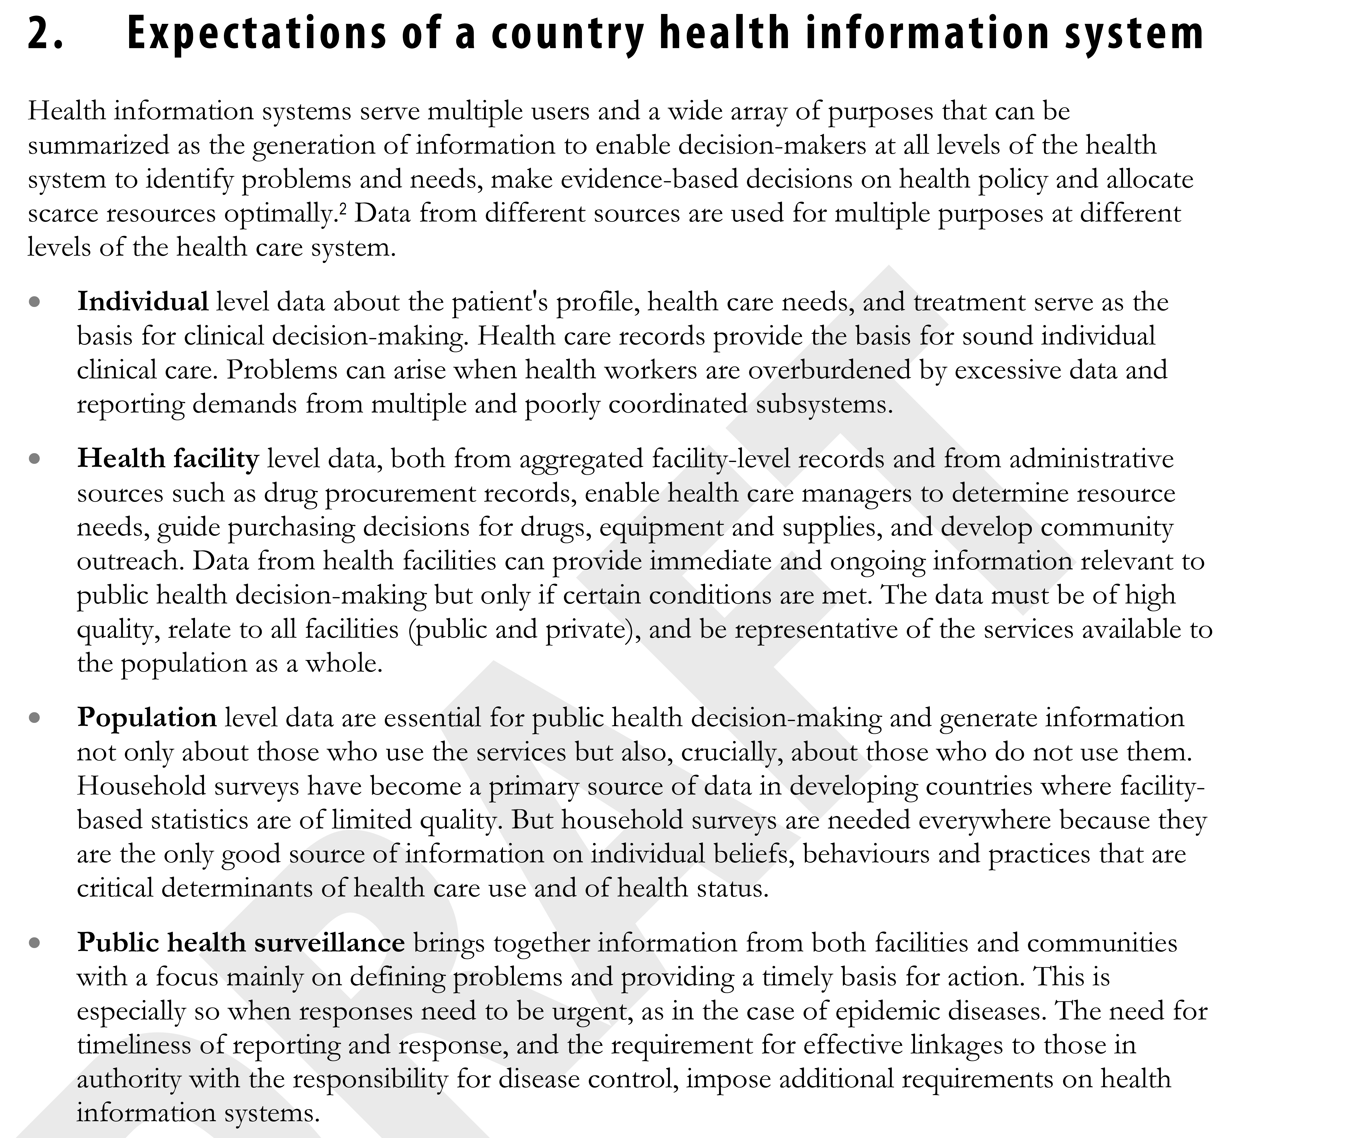
Health management information systems
Countries have always generated/used data.
Nationalized systems garnered global attention beginning in mid-1990s.
Standardize processes
Common indicators
Universal systems such as DHIS2

Slide 5
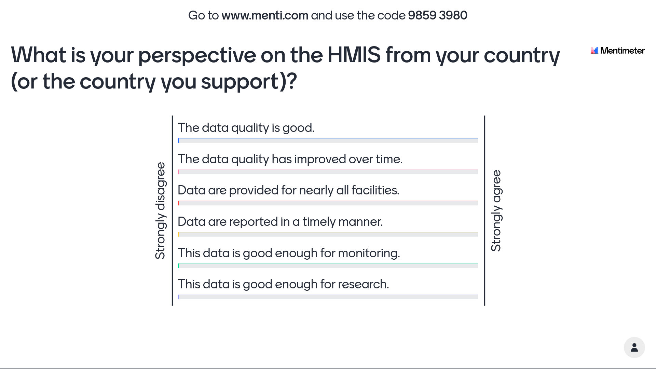

Slide 6
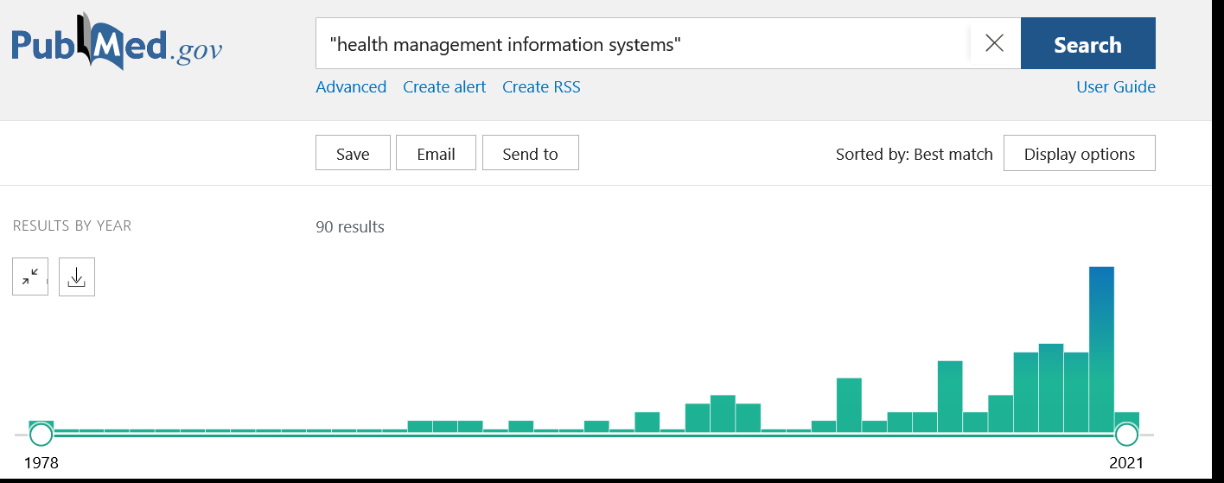
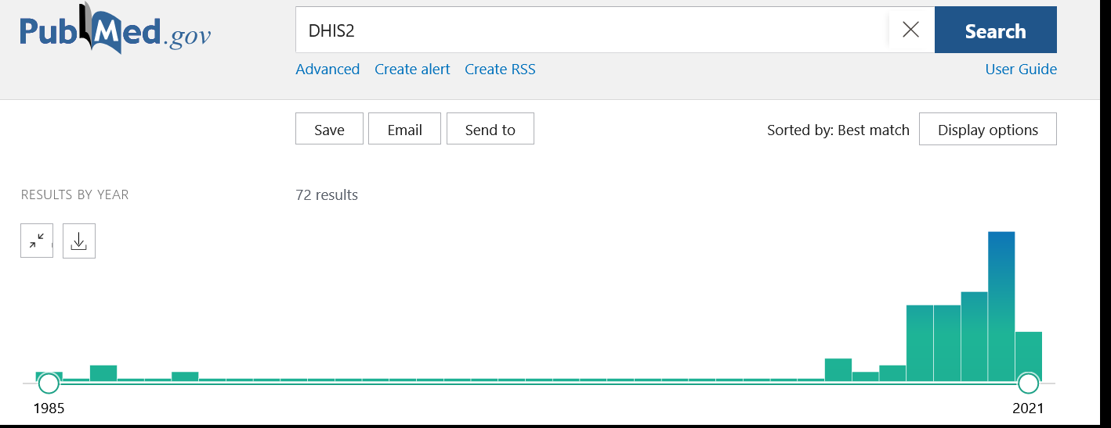

Slide 7
Flow of HMIS data
Patient File
District Report
Facility registers/
Aggregate facility report
Patient File
Patient File
Patient File
Facility registers/
Aggregate facility report
Electronically entered
Facility registers/
Aggregate facility report
Notes:
7

Slide 8
Flow of HMIS data
Patient File
Facility registers/
Aggregate facility report
Electronically entered
Patient File
Patient File
Patient File
Facility registers/
Aggregate facility report
Facility registers/
Aggregate facility report
Notes:
8

Slide 9
Quality of data recorded?
Is it complete?
Is it valid?
Is it reliable?
Is it accurate?
Level of difficulty
9
Notes:
Note to facilitator:
Describe how data quality can undermine the quality of an indicator.
Completeness – is there something in the field?
Valid – is what is in the field in a plausible range?
Reliable – is what is in the field consistent with another source?
Accurate – is what is in the field reflecting the truth?
Quality is harder to assess as you move up the chain.

Slide 10
Completeness and validation

Slide 12
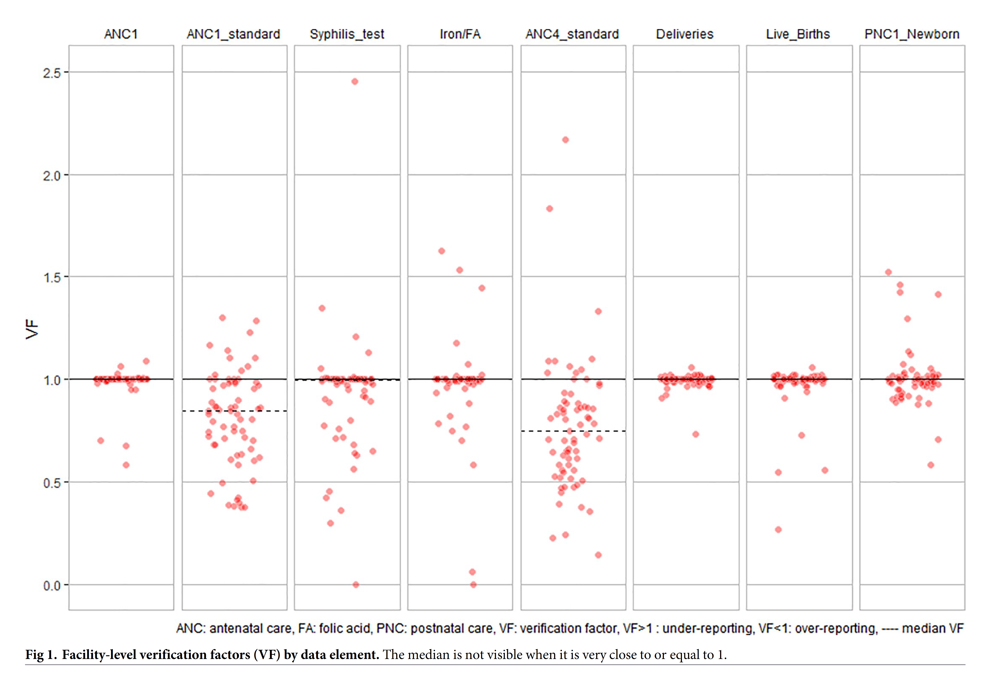
Reliability

Slide 13
Accuracy

Slide 14
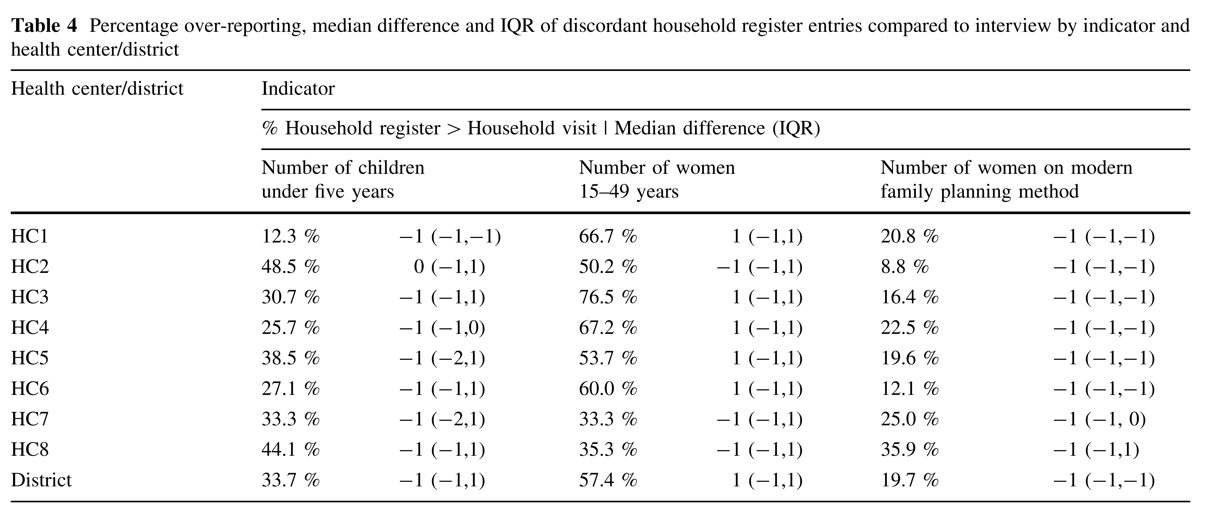

Slide 15
High-level thoughts on HMIS quality
There is no such thing as perfect data.
Important to monitor quality of your data:
Good enough to use?
Ways to improve?
Even imperfect data can be usable data.
Can throw out clear mistakes.
If bias is consistent, then can still detect outliers.
May be able to fill in missing values.

Slide 16
Outliers

Slide 17
A note
In this session, we will discuss outliers and missing data in the context of fitting a time series model for a single facility and indicator
Notes:
Misentered;
Nearby clinic shut down so individuals came to this clinic for one month

Slide 18
Types of outliers
Outliers are data points that are very different from the majority of observations in the time series
There are various types of outliers:
Errors in data entry
Unusual cases
Global outlier: raw values are significantly larger or smaller than the rest of the values.
Contextual outlier: higher or lower value than you would expect based on the patterns and trends of the time series
Notes:
Misentered;
Nearby clinic shut down so individuals came to this clinic for one month

Slide 19
How do we detect outliers?
Method 1: Visual inspection
Hard to detect outliers with time series data due to seasonality
Method 2: Tukey’s rule (larger than 1.5*IQR values)
Does not capture the seasonal nature
Boxplots by month – but would not capture trend & need many years of data
Boxplots by year – but would not capture seasonality
Method 3: Fit time series model and apply statistical test
Captures trend & seasonality, but it is model dependent

Slide 20
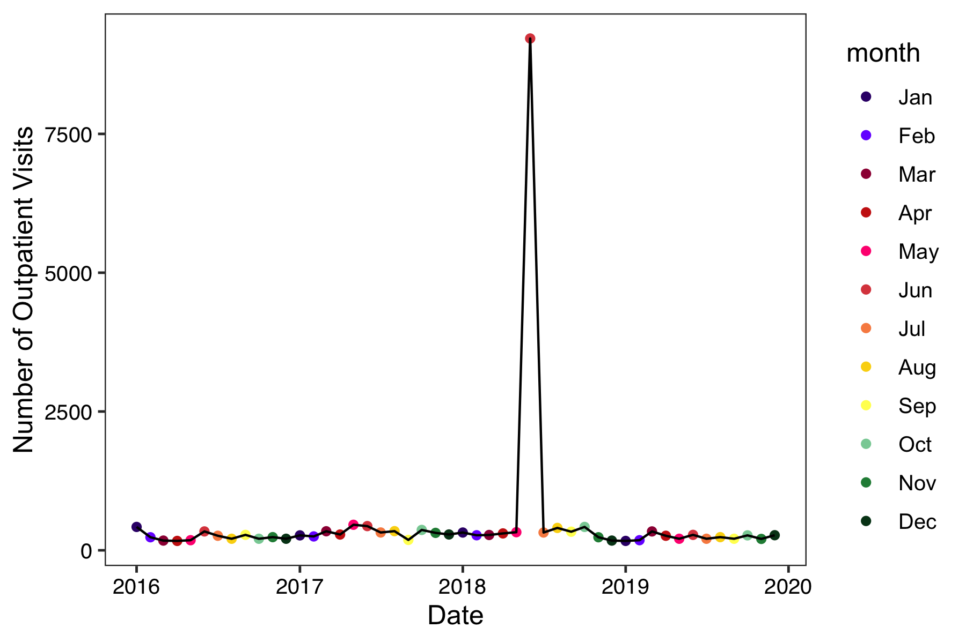
Method 1: Visual inspection
Error?
Global outlier?
Contextual outlier?
Jayproken Clinic in Liberia
Notes:
ACTIVITY: POLL FOR ALL VISUAL INSPECTION SLIDES

Slide 21
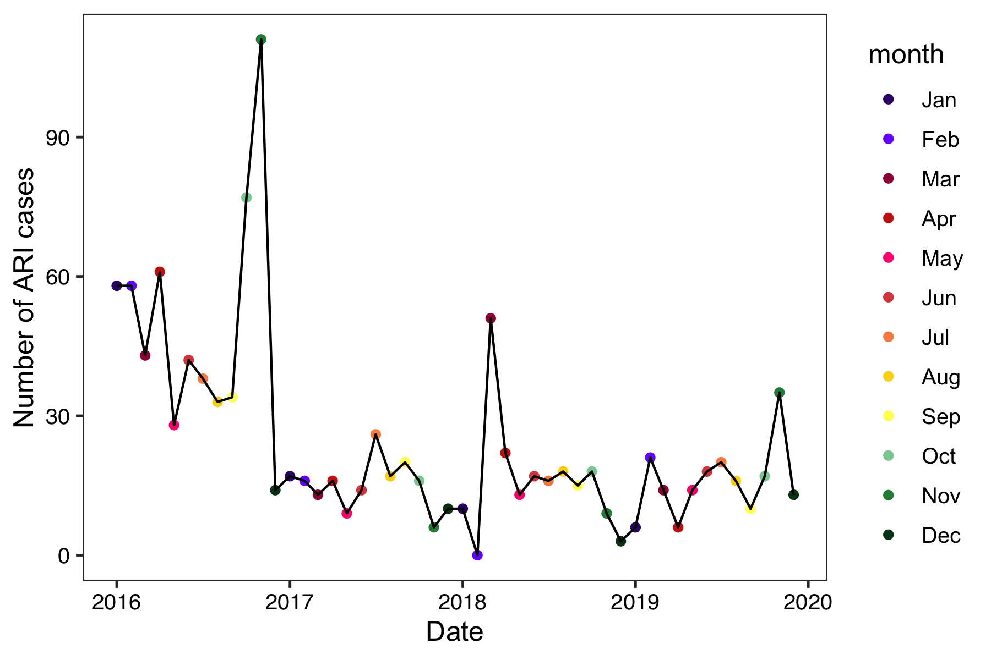
Method 1: Visual inspection
Error?
Global outlier?
Contextual outlier?
St. Francis Clinic in Liberia
Notes:
ACTIVITY: POLL FOR ALL VISUAL INSPECTION SLIDES

Slide 22
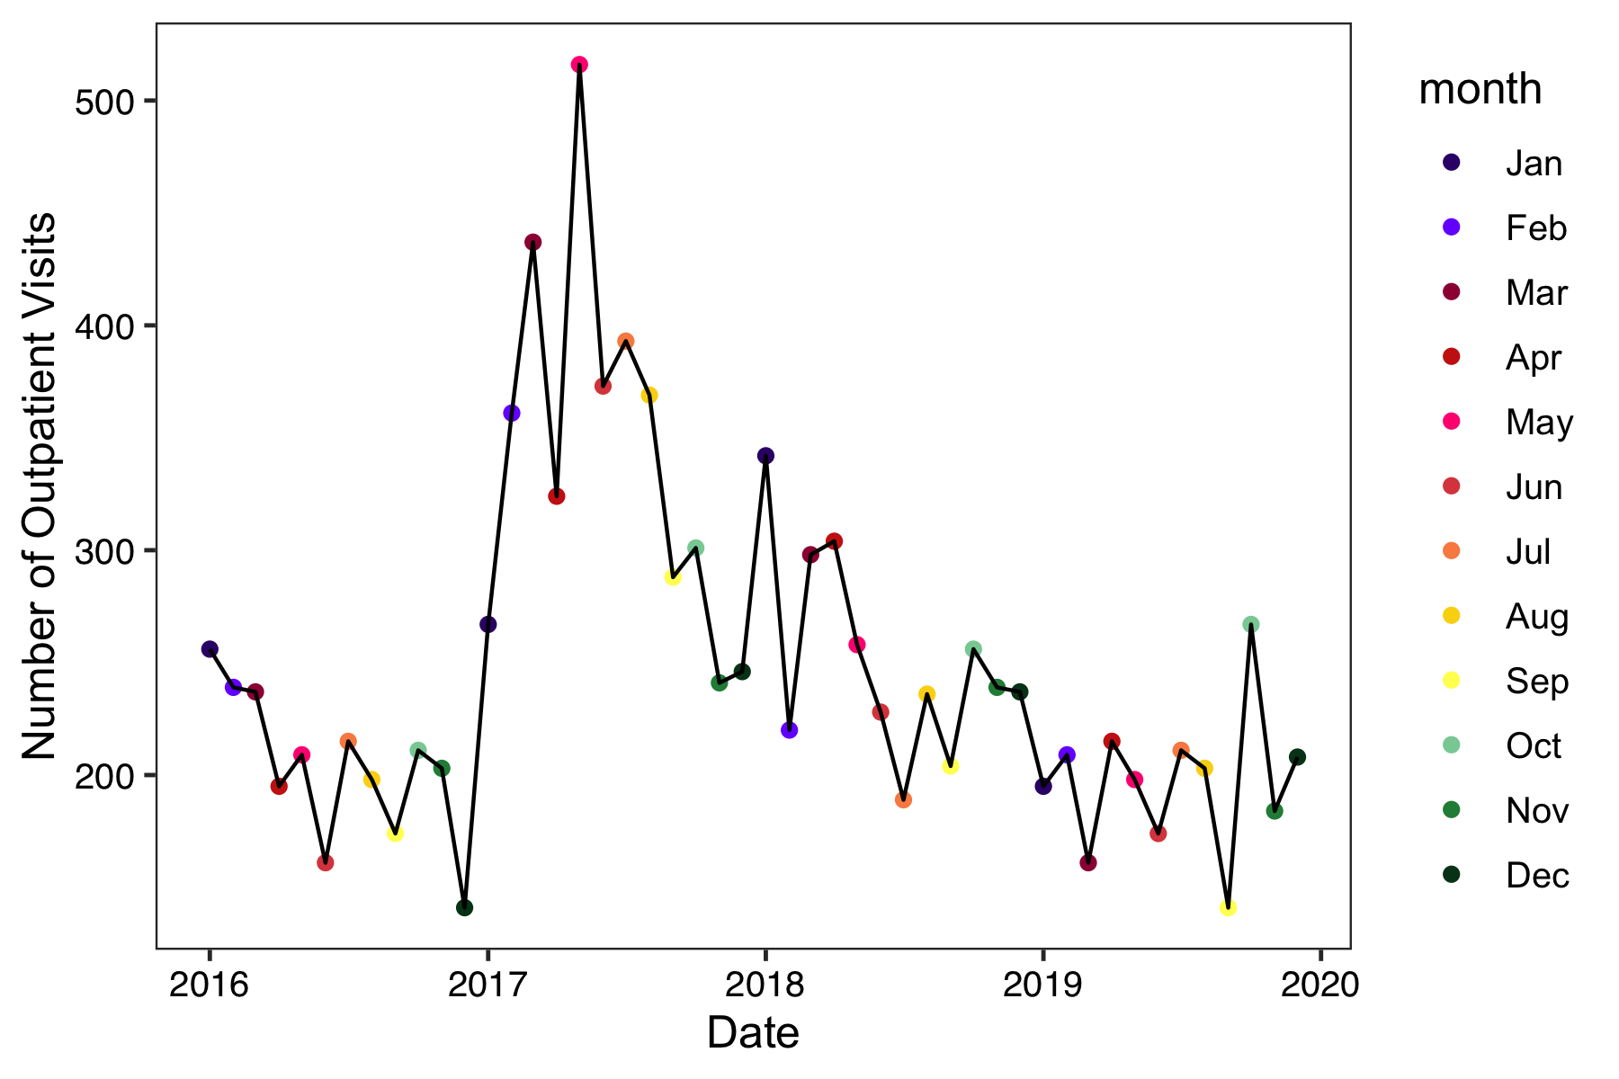
Method 1: Visual inspection
Error?
Global outlier?
Contextual outlier?
Yangaya Clinic in Liberia
Notes:
ACTIVITY: POLL FOR ALL VISUAL INSPECTION SLIDES

Slide 23
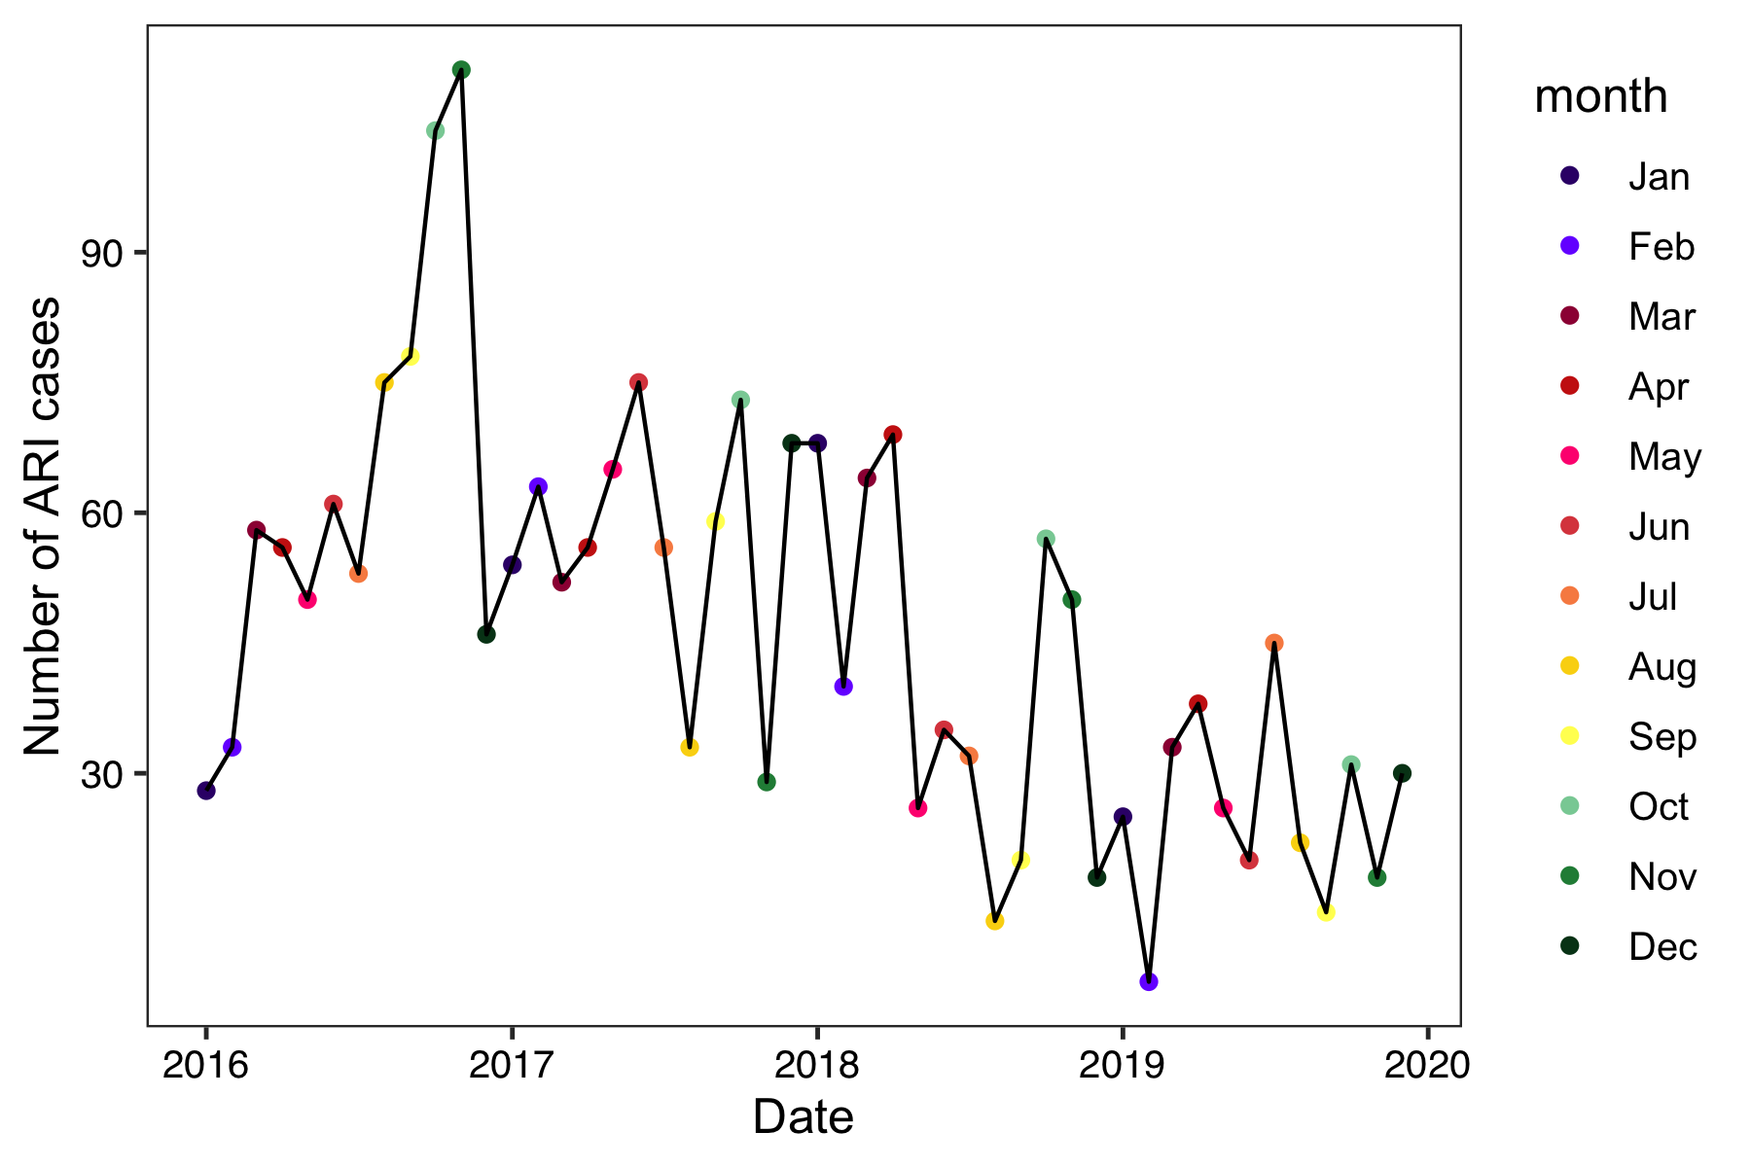
Method 1: Visual inspection
Error?
Global outlier?
Contextual outlier?
Boniken Clinic in Liberia
Notes:
ACTIVITY: POLL FOR ALL VISUAL INSPECTION SLIDES

Slide 24
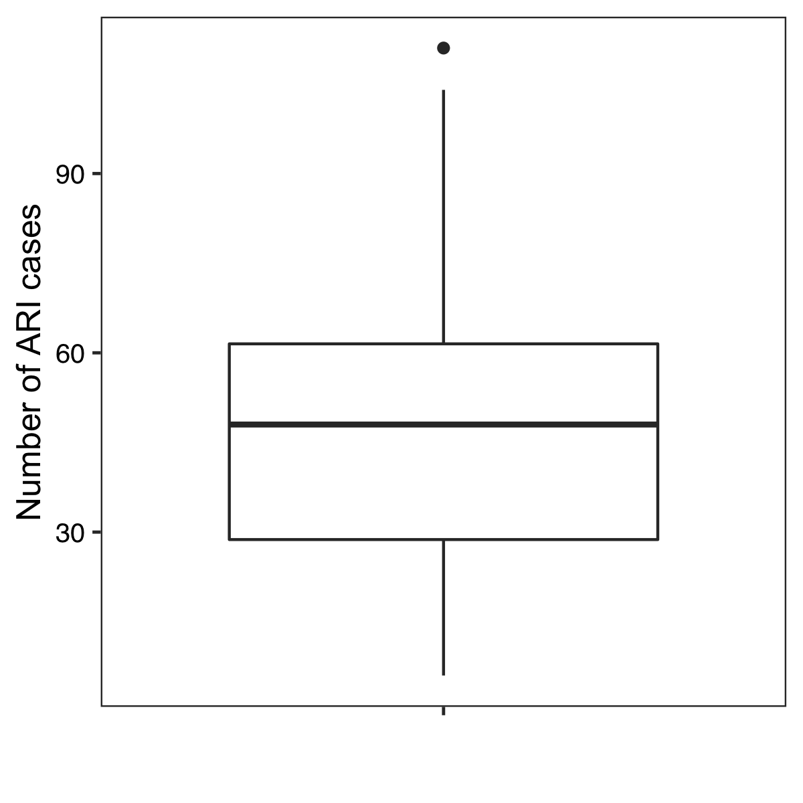
Method 2: Tukey’s rule
Boniken Clinic in Liberia

Slide 25
Method 2: Tukey’s rule
Q75 + 1.5*IQR
75th percentile
median
25th percentile
Q25 – 1.5*IQR
Boniken Clinic in Liberia

Slide 26
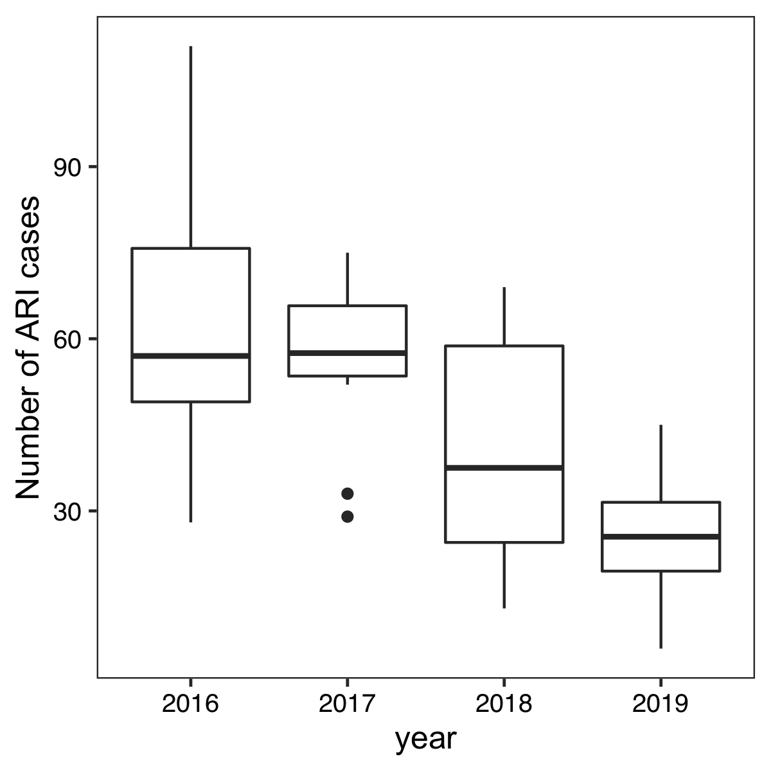
Method 2: Tukey’s rule
Boniken Clinic in Liberia

Slide 27
Method 2: Tukey’s rule
Boniken Clinic in Liberia

Slide 28
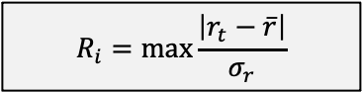
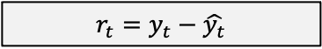
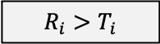
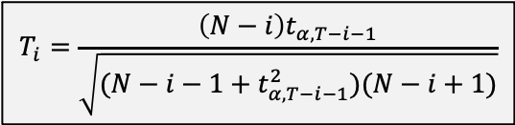
Method 3: Apply statistical test
Fit time series model (Sessions 2 & 3)
Calculate residuals (observed - predicted)
Calculate test statistic (Grubb’s test)
Calculate critical value
Compare test statistic to critical value
If larger, then remove the largest residual and repeat steps
If smaller, then no outliers identified
The residuals removed are the outliers
$$r_{t}=y_{t}−\hat{y_{t}}$$
$$R_{i}=\max{\frac{\left|r_{t}−\overline{r}\right|}{σ_{r}}}$$
$$T_{i}=\frac{\left(N−i\right)t_{α,T−i−1}}{\sqrt{(N−i−1+t_{α,T−i−1}^{2})(N−i+1)}}$$
$$R_{i}>T_{i}$$

Slide 29
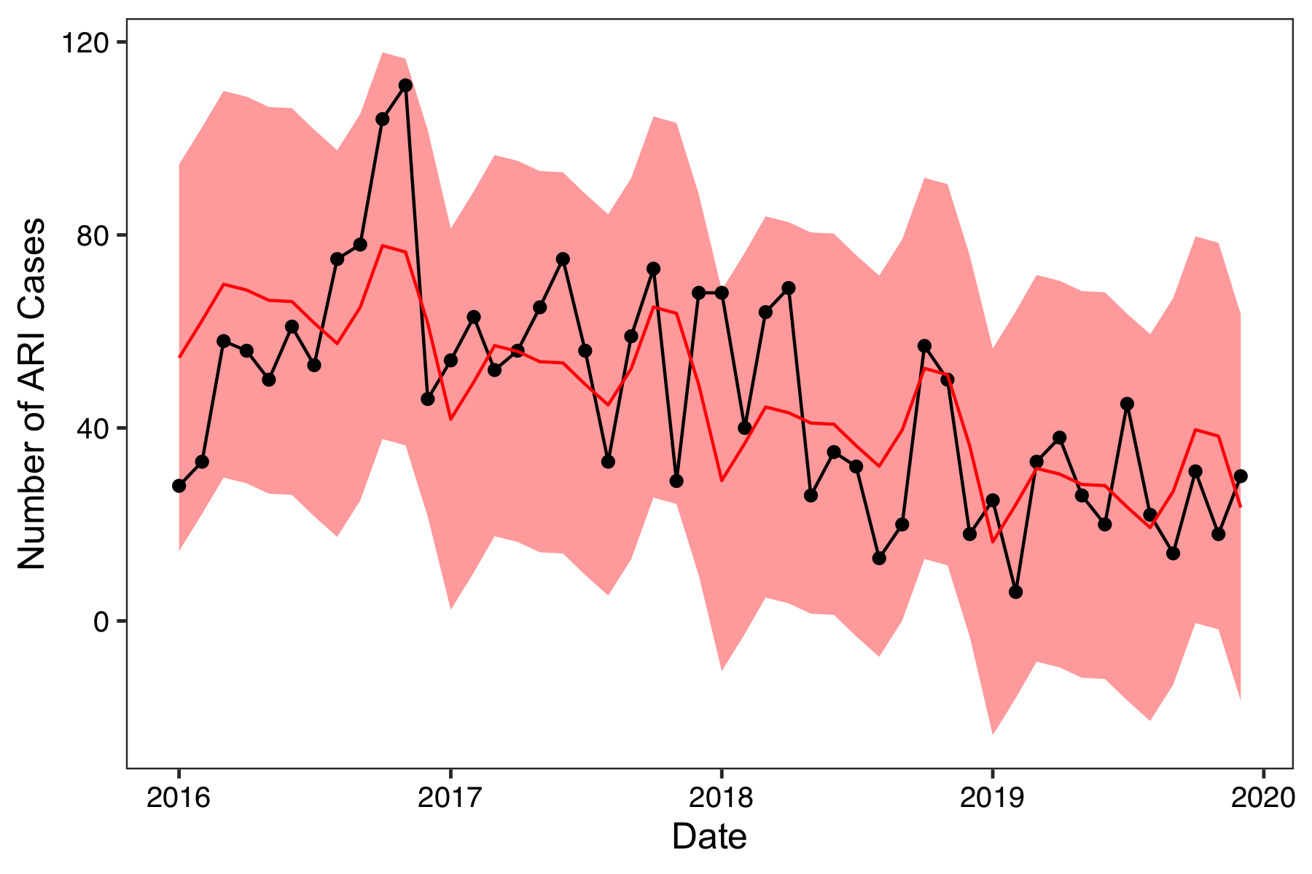
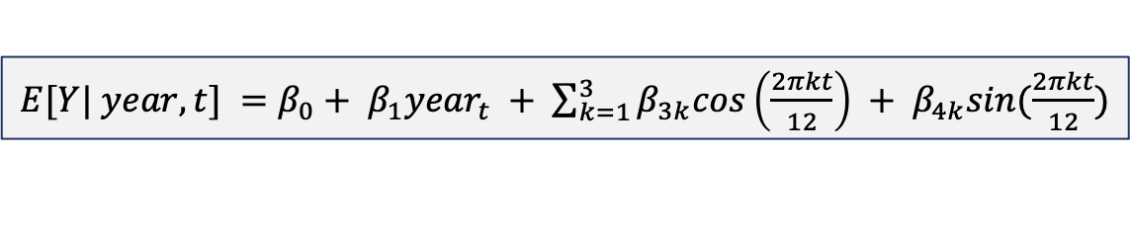
Method 3: Apply statistical test
$E[Y| year, t] =β_{0}+ β_{1}{year}_{t} + \sum_{k=1}^{3}{β_{3k}cos\left(\frac{2πkt}{12}\right)} + β_{4k}sin(\frac{2πkt}{12})$

Slide 30
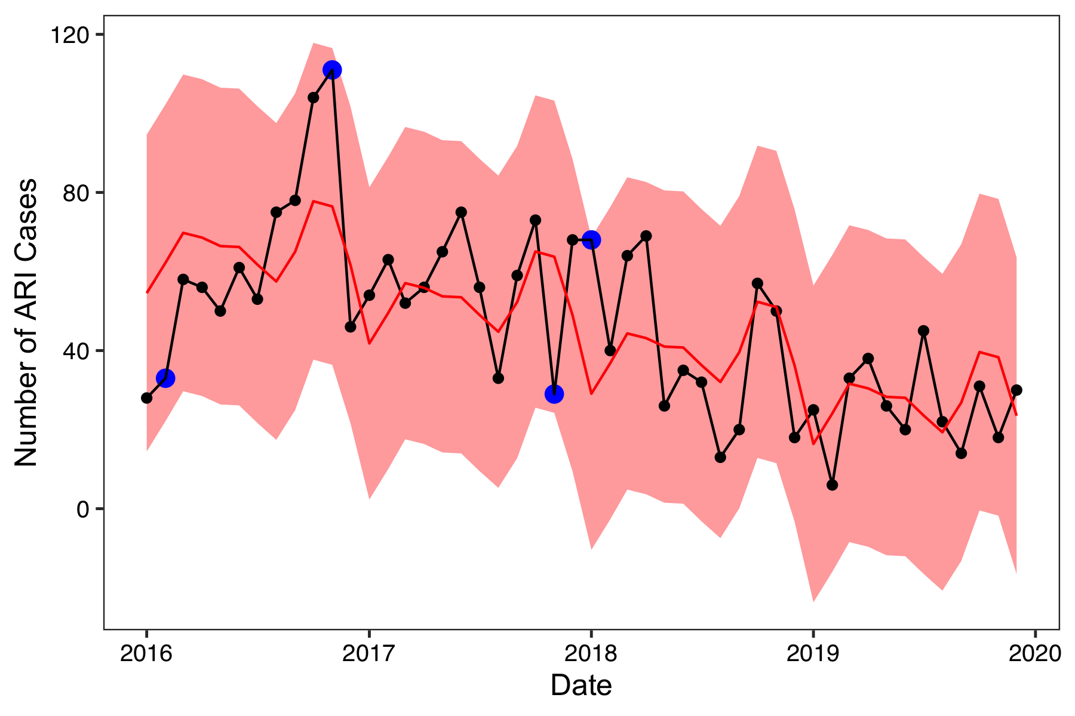
Method 3: Apply statistical test
Not previously identified
Not previously identified

Slide 31
Solutions: Outliers
If an outlier is suspected, it is important to investigate why the data point may be an outlier
Was it an anomaly?
If concerned about model fit, include a dummy variable for the time point(s)
Was it a data entry error?
Can it be replaced with the correct/true value?
If not, then code as missing value

Slide 32
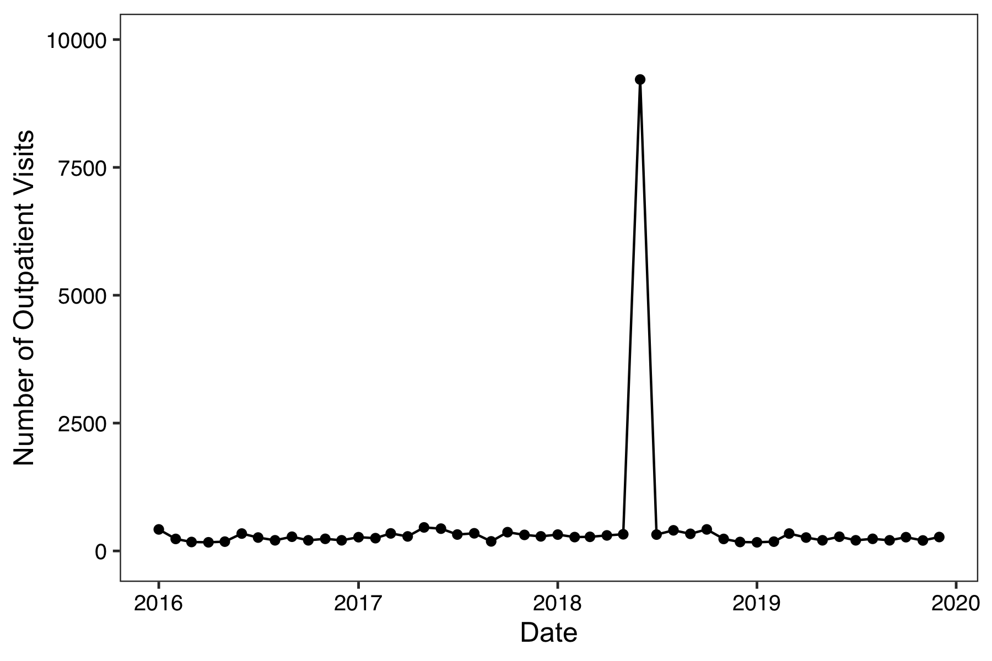
Solutions: Data entry error
Jayproken Clinic in Liberia

Slide 33
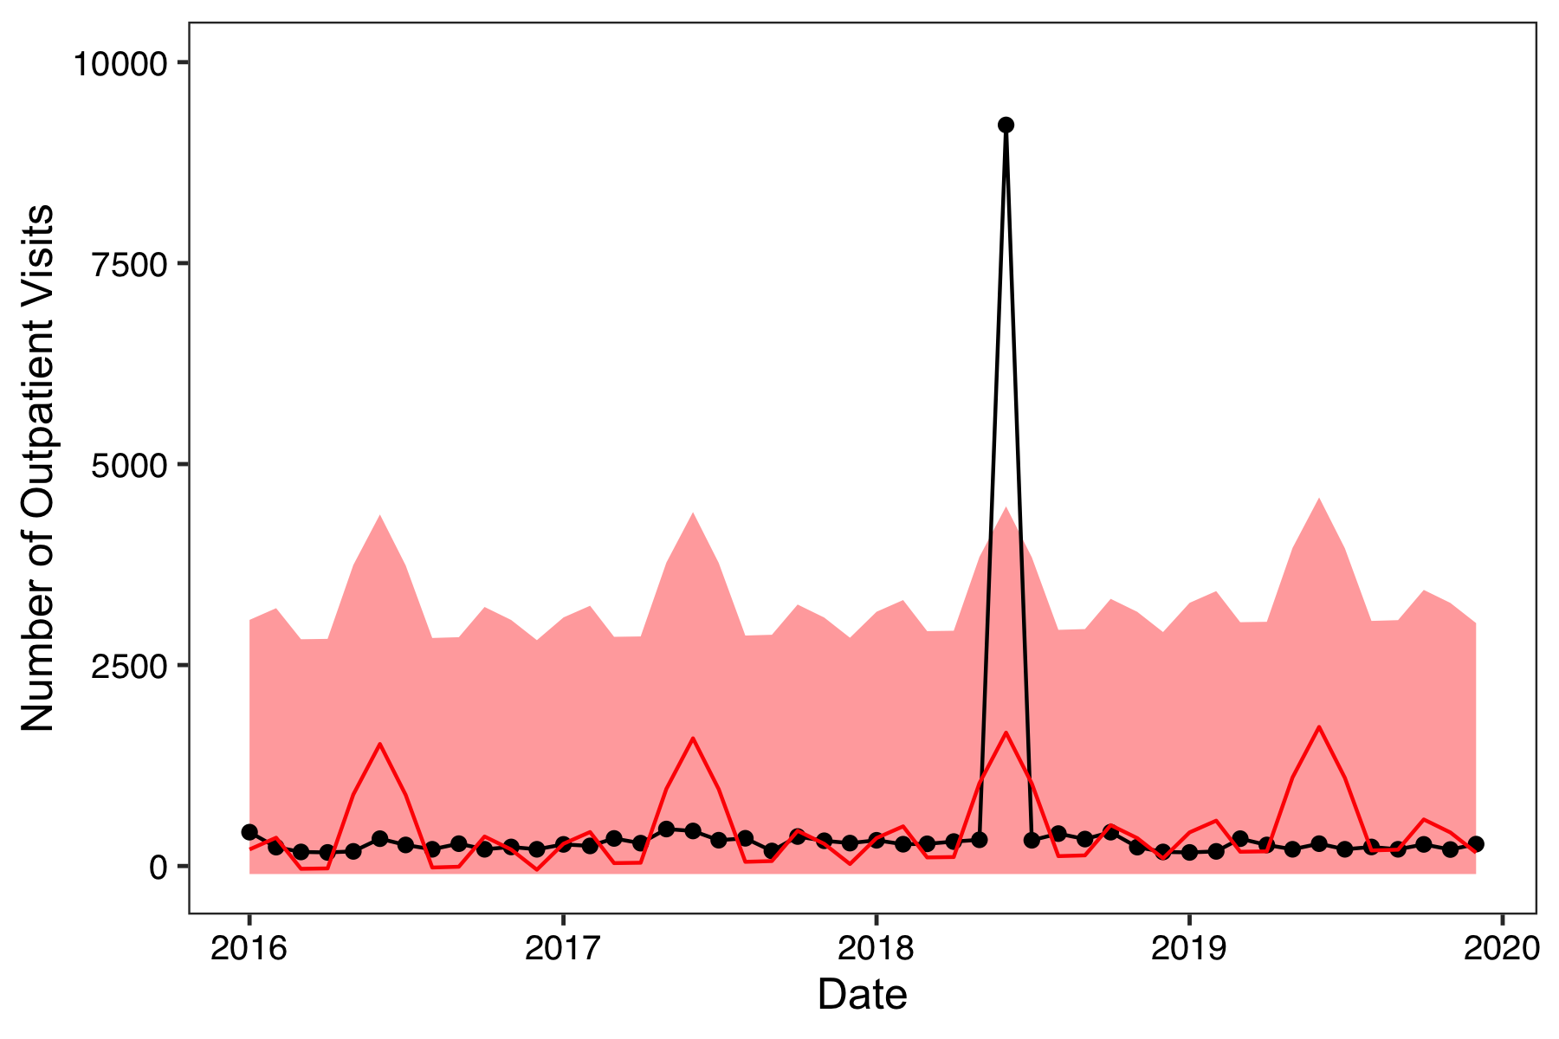
Solutions: Data entry error
Jayproken Clinic in Liberia

Slide 34
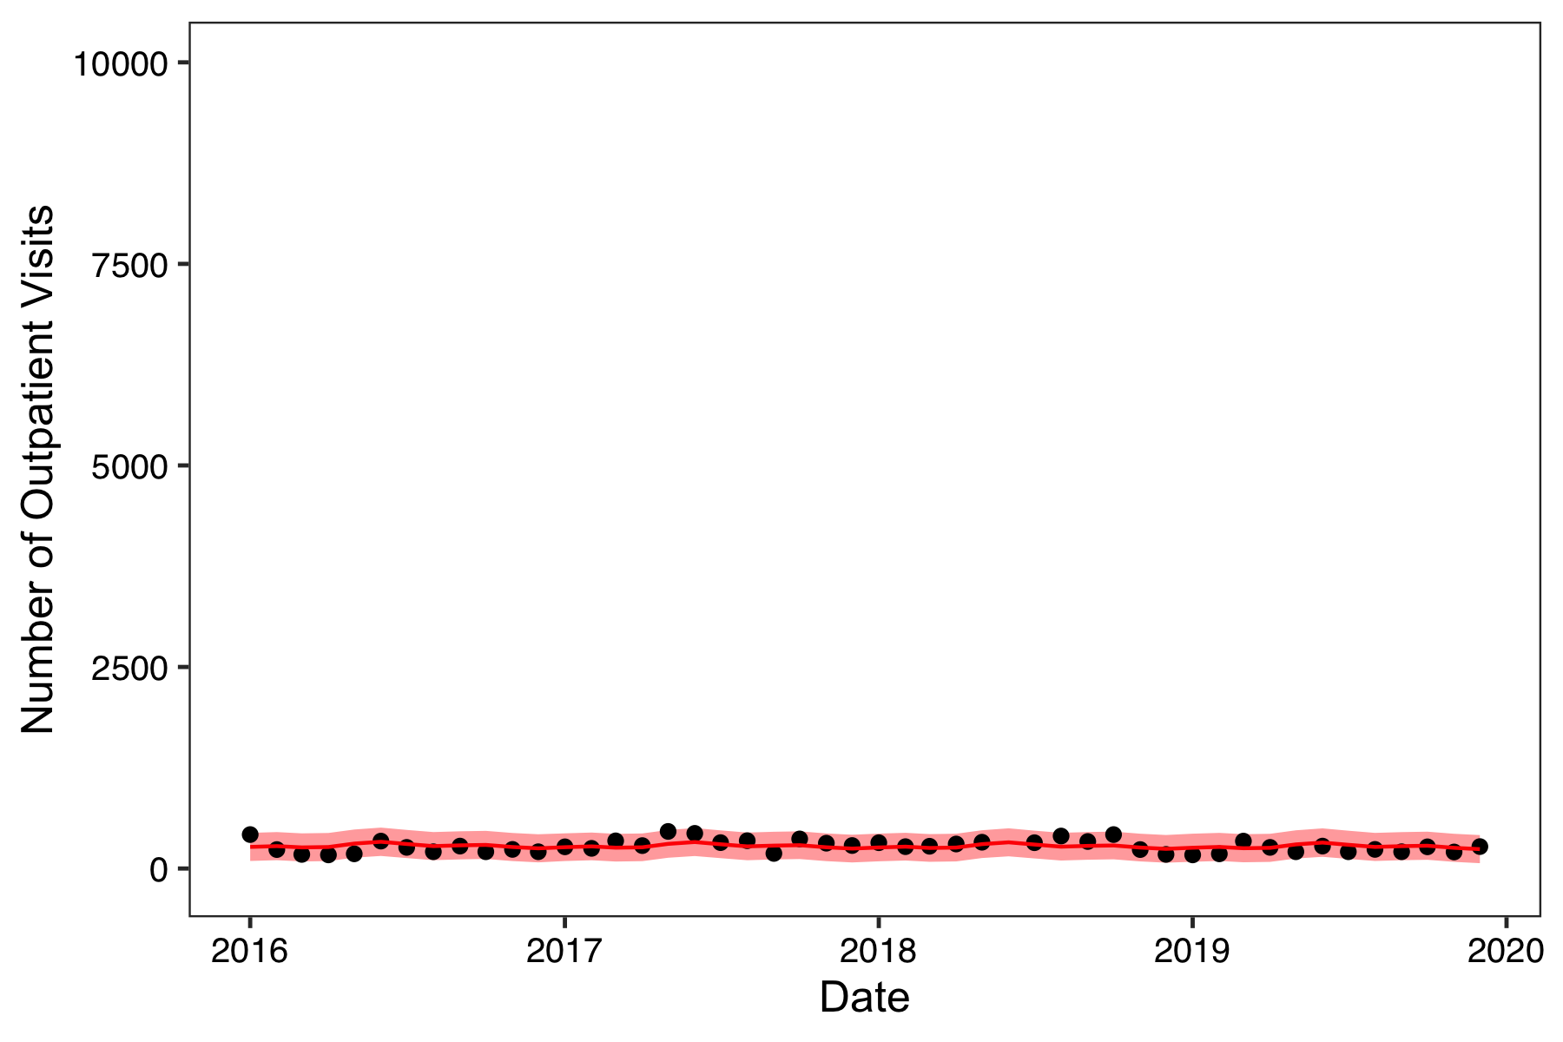
Solutions: Data entry error
Jayproken Clinic in Liberia

Slide 35
Missing data

Slide 36
Considerations for missing data
To help determine if and how missing data should be addressed:
What is the research question?
Why is the data missing?
Is there enough information to address missing data?
How much data is missing?
Is there additional information available to “fill in” missing values?

Slide 37
1. What is the research question?
Describe the behavior of an indicator over time
May be of interest to describe missing data pattern
May want to “fill in” a reasonable value for missing month in figures

Slide 38
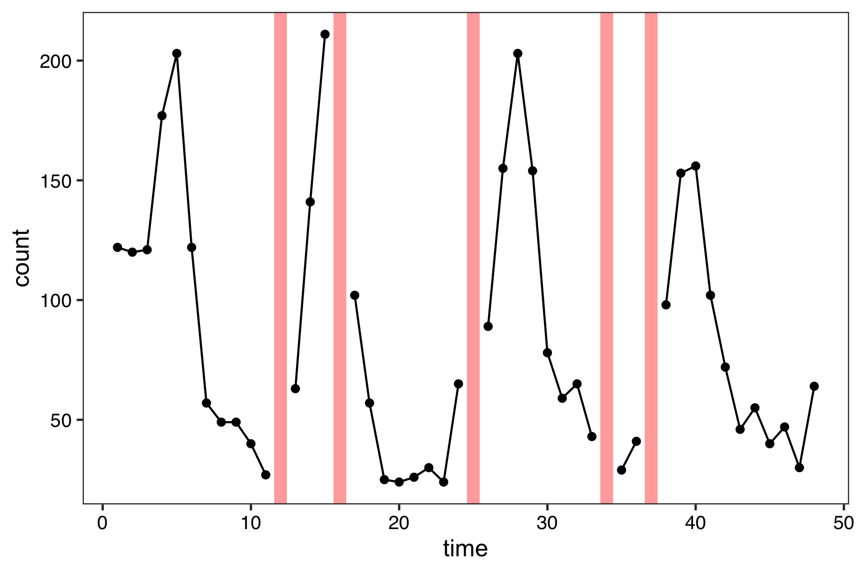
1. What is the research question?
Describe the behavior of an indicator over time
Can perform single imputation based on:
Mean
Interpolation
Model-based

Slide 39
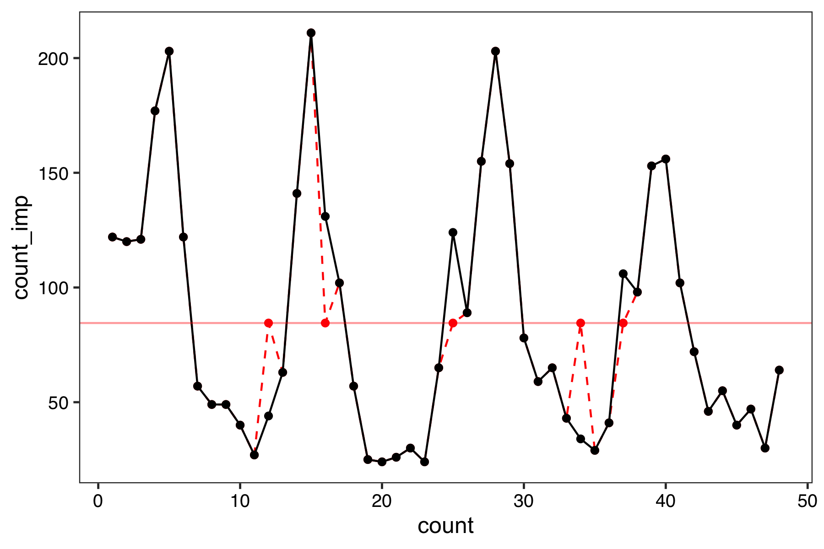
1. What is the research question?
Describe the behavior of an indicator over time
Can perform single imputation based on:
Mean
Interpolation
Model-based
number of malaria cases

Slide 40
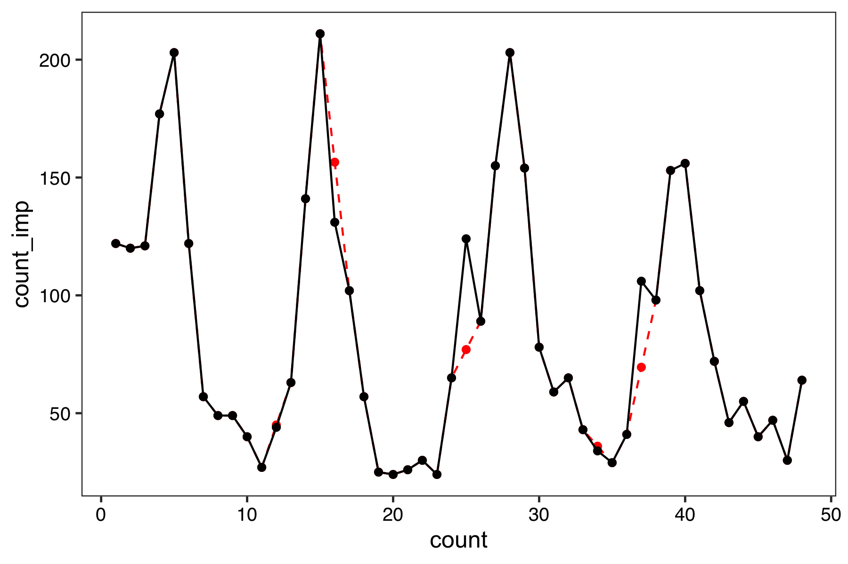
1. What is the research question?
Describe the behavior of an indicator over time
Can perform single imputation based on:
Mean
Interpolation
Model-based
number of malaria cases

Slide 41
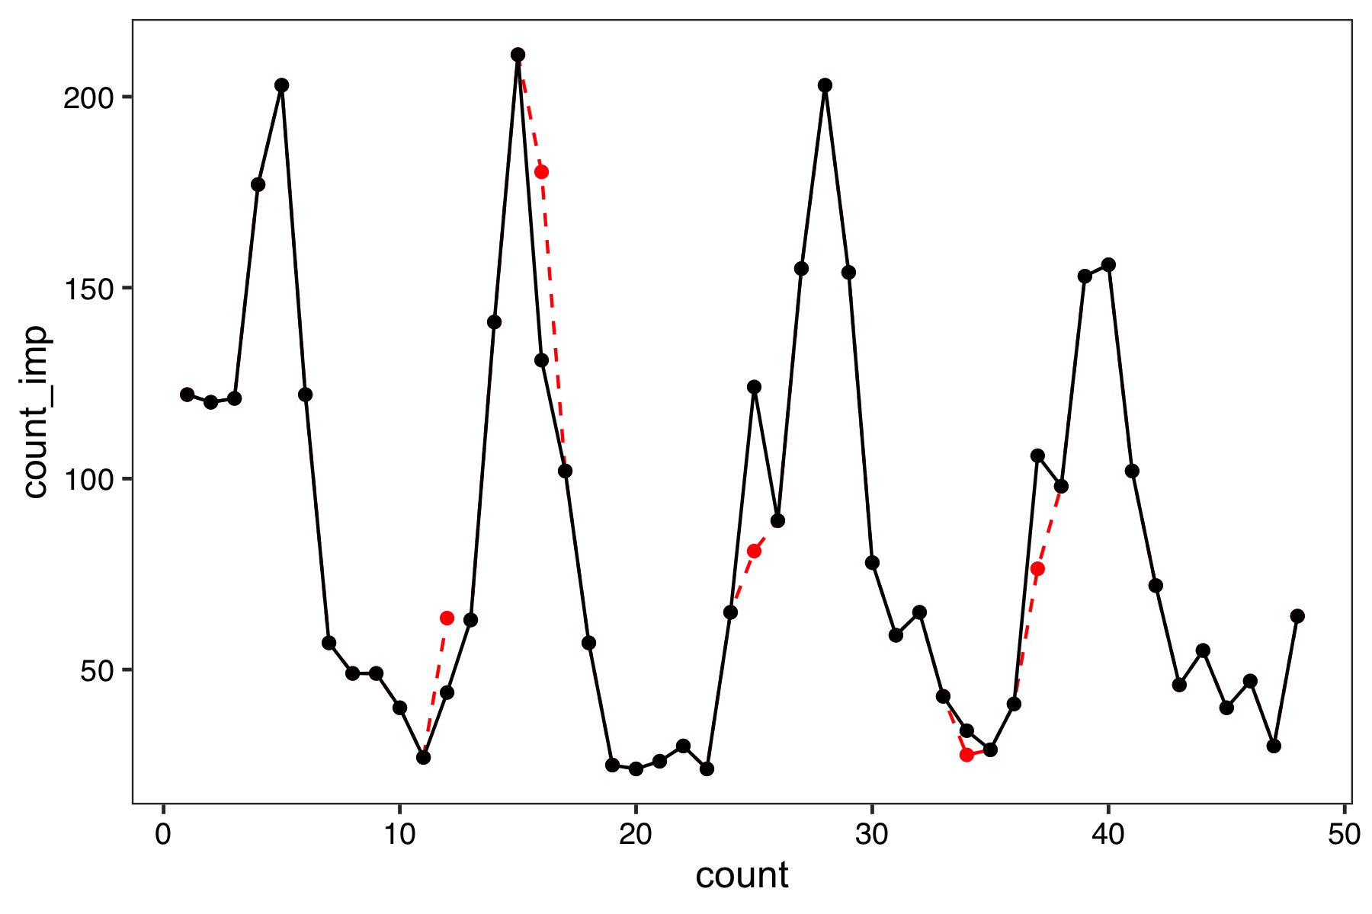
1. What is the research question?
Describe the behavior of an indicator over time
Can perform single imputation based on:
Mean
Interpolation
Model-based
number of malaria cases

Slide 42
1. What is the research question?
Describe the behavior of an indicator over time
May be of interest to describe missing data pattern
May want to “fill in” a reasonable value for missing month in figures
Detect deviations from expected in an indicator (syndromic surveillance)
Want to build a valid baseline model for each facility, which can be biased if data is missing
Want to aggregate data across multiple facilities
Need to be careful about “borrowing” information from the baseline period for missing values in evaluation period
Measure the impact of an intervention on an indicator
Want to construct valid estimates, which can be biased if data is missing

Slide 43
2. Why is the data missing?
Missing completely at random
Missing pattern is random (can ignore: “complete case”)
Missing at random
Missing pattern can be fully identified using observed data (e.g. other facilities or external data sources)
Missing not at random
Missing pattern cannot be identified from the observed data
Very challenging and often results in calculating reasonable “bounds” for predicted values
Notes:
MCAR means there is no relationship between the missingness of the data and any values, observed or missing.
Missing at Random, MAR, means there is a systematic relationship between the propensity of missing values and the observed data, but not the missing data.
Missing Not at Random, MNAR, means there is a relationship between the propensity of a value to be missing and its values.
GROUP ACTIVITY: https://docs.google.com/presentation/d/1QhRqyj0UJUtVCmGAoEmXCcHZQfCVg-Jbge03o8Yc7v8/edit?usp=sharing

Slide 44
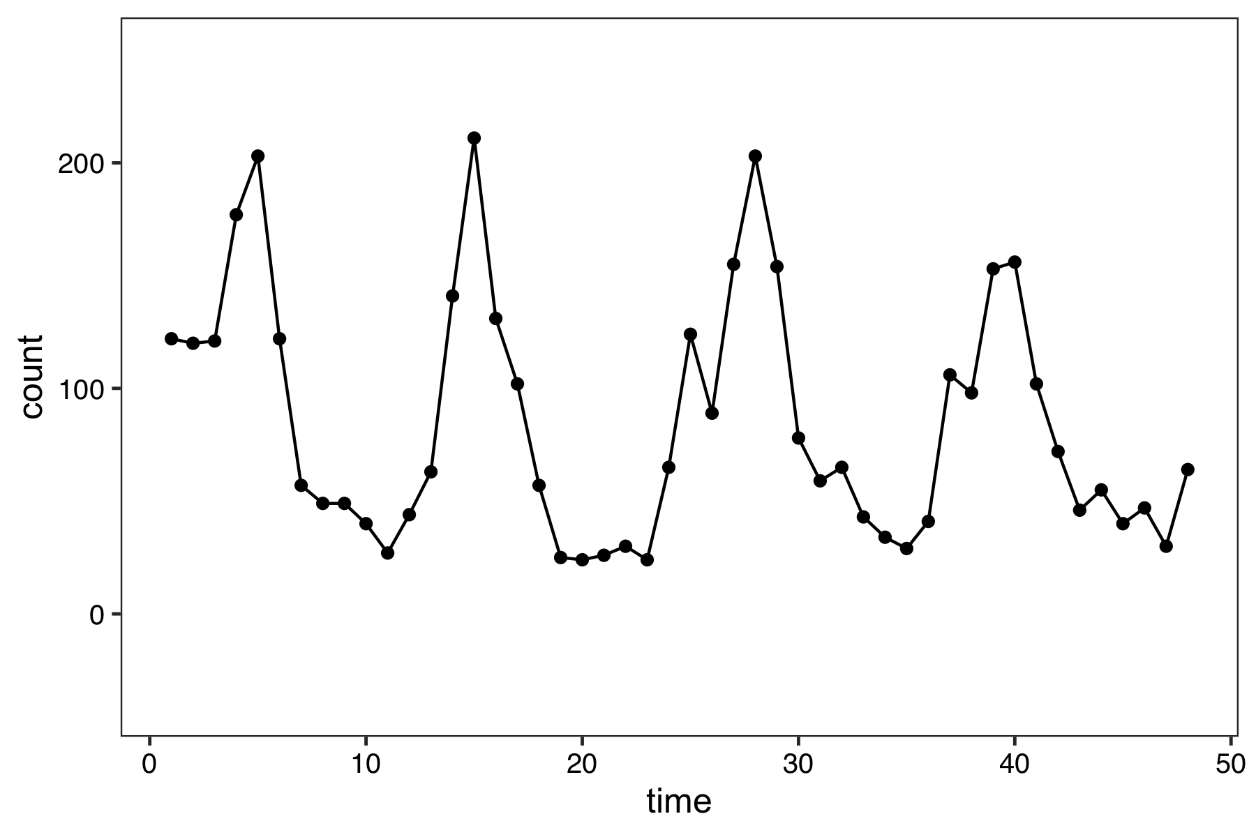
Missing data patterns in time series data
No missing data
MCAR
Not MCAR

Slide 45
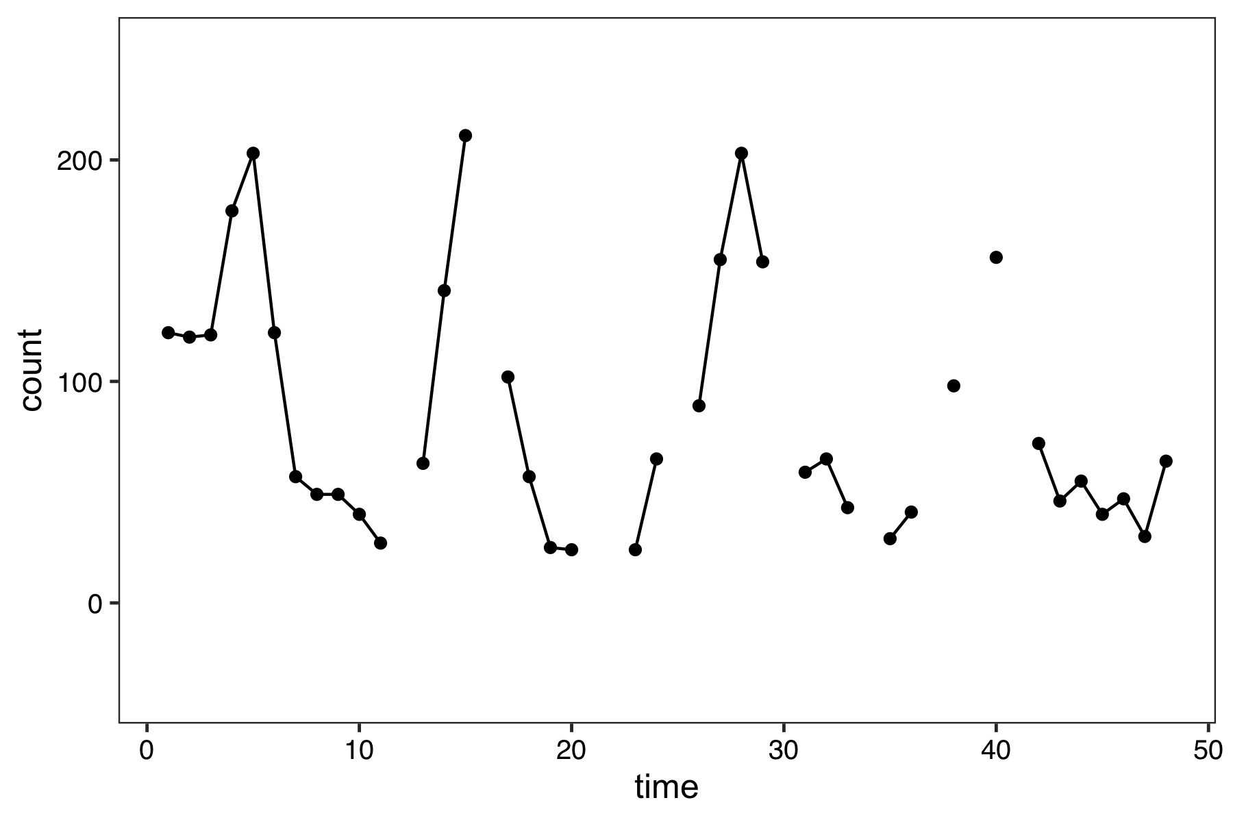
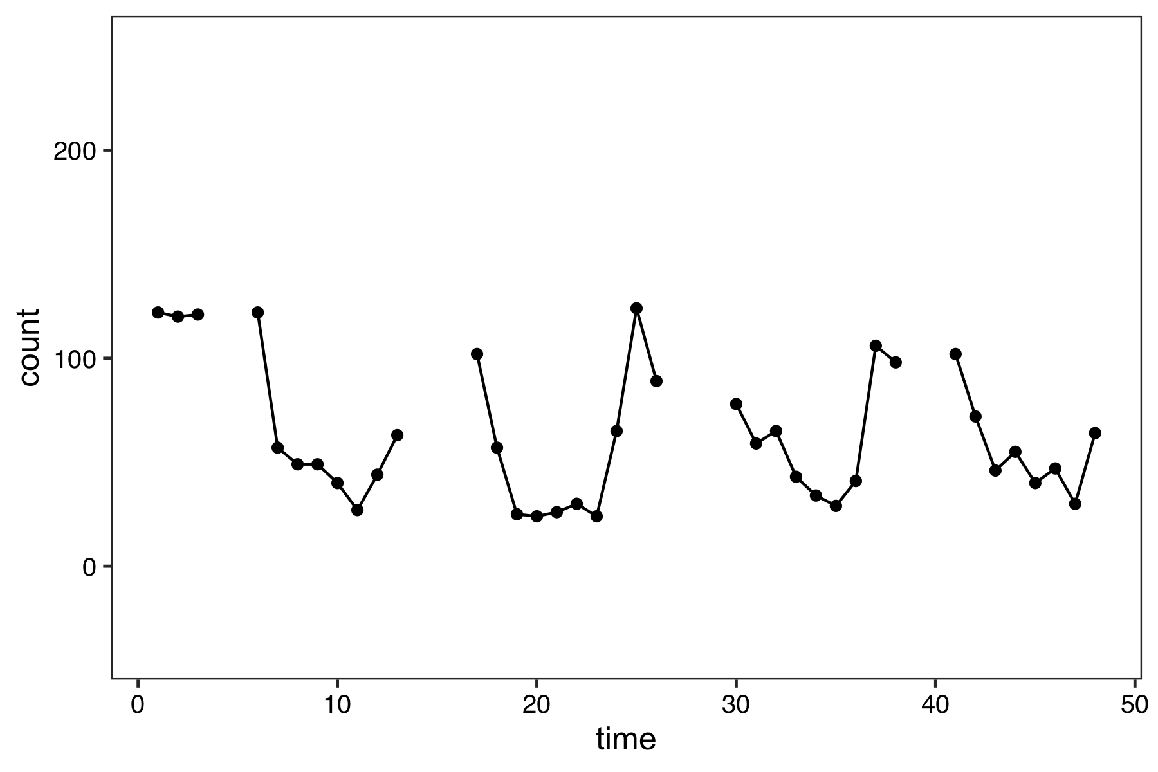
Missing data patterns in time series data
No missing data
MCAR
Not MCAR
remove 10 random points
remove the 10 largest points

Slide 46
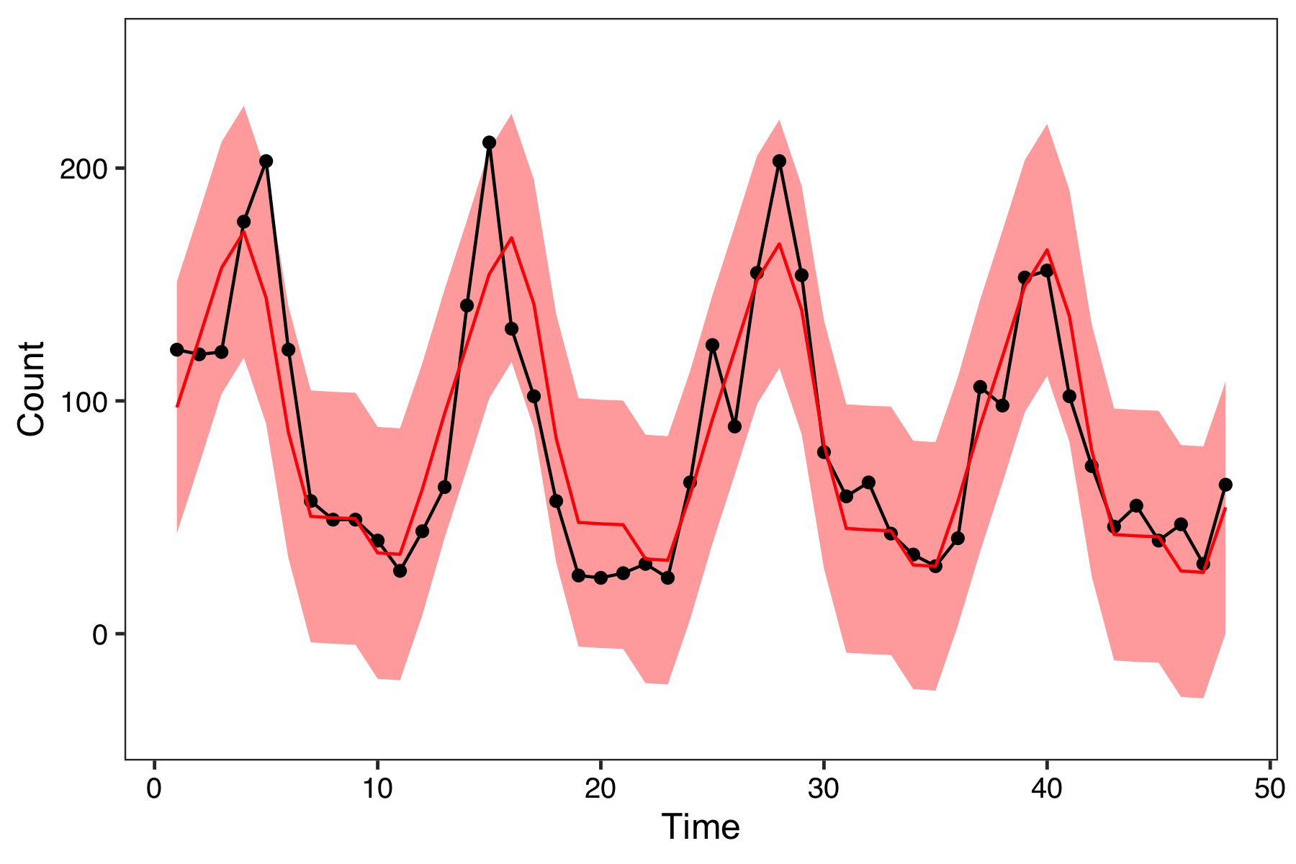
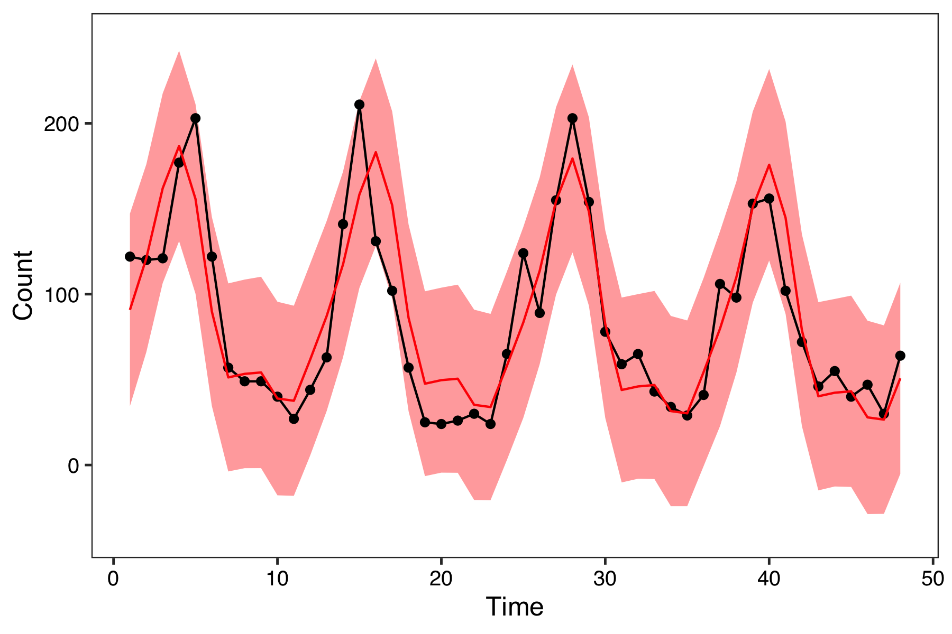
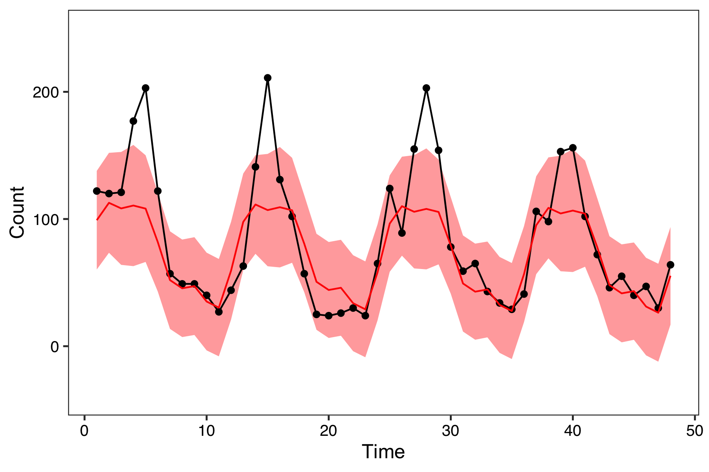
Missing data patterns in time series data
No missing data
MCAR
Not MCAR
Notes:
If missing completely at random, can ignore

Slide 47
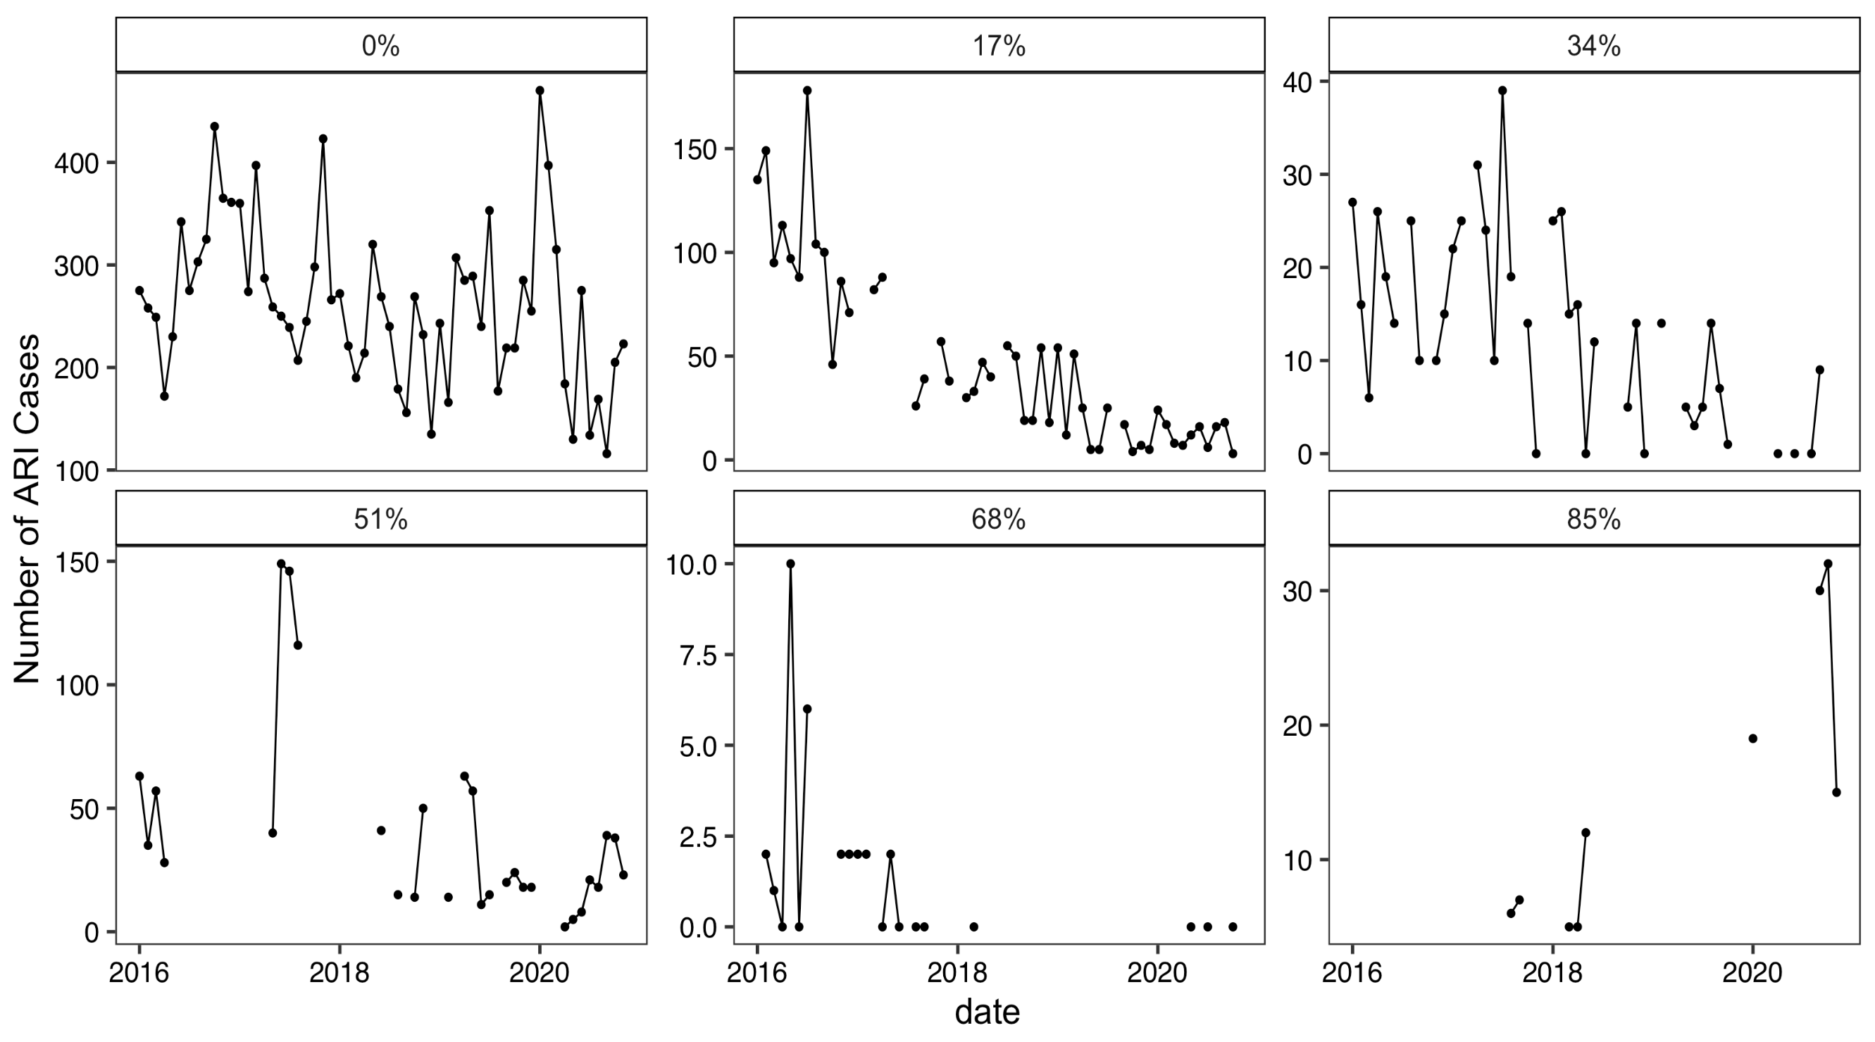
3. Is there enough information?
How much data is missing?

Slide 48
3. Is there enough information?
Is there additional information available to “fill in” missing values?
Data from other facilities
Can use “similar” facilities (neighboring, same size or type, or correlated seasonal patterns) to impute missing values
Other indicators
Health service utilization indicators that are correlated with indicator could be used to impute missing values in a given facility
Need to make sure they do not have similar missingness patterns
External (non-DHIS2) sources
Weather of rainfall data
Mobility data
Many statistical methods to incorporate these data sources!

Slide 49
Solution: Syndromic Surveillance
Goal 1: Create baseline facility-level models for prediction
Chose not to model facilities with >20% of months missing
This was “not enough information to draw conclusions”
Fit facility-level models on complete case data
Goal 2: Create baseline aggregate-level models for prediction
To calculate aggregate-level monthly predictions, sum predicted monthly counts across facilities by “drawing” from facility-level complete case models
Future direction: Utilize information from “similar” facilities and indicators to fill in missing values (previous slide)
Notes:
What is the research question?
Why is data missing?
Is there enough information to address missing data?
This assumes data is missing at random

Slide 50
Lab: Data formatting and cleaning
Nichole will lead the lab today
Work on cleaning and formatting data for analysis
Examples with outliers and missing data

Slide 51
Final lecture: Data visualization for syndromic surveillance

